Slide 1


Fundraising

Slide 2


Nonprofit Leadership
Development and Support
Wendy Burtner
wendy@nonprofitsidekick.com
Stephanie Masters SHRM-SCP
steph@nonprofitsidekick.com
www.nonprofitsidekick.com

Slide 3
Agenda
Introductions
Types of Income for Nonprofits
Contributed Income
Earned Revenue
Income Mix - What’s right for your org?
How to get started

Slide 4
Contributed Income - Who gives?
Foundations
Corporations
Government
Individuals
Individuals

Slide 5


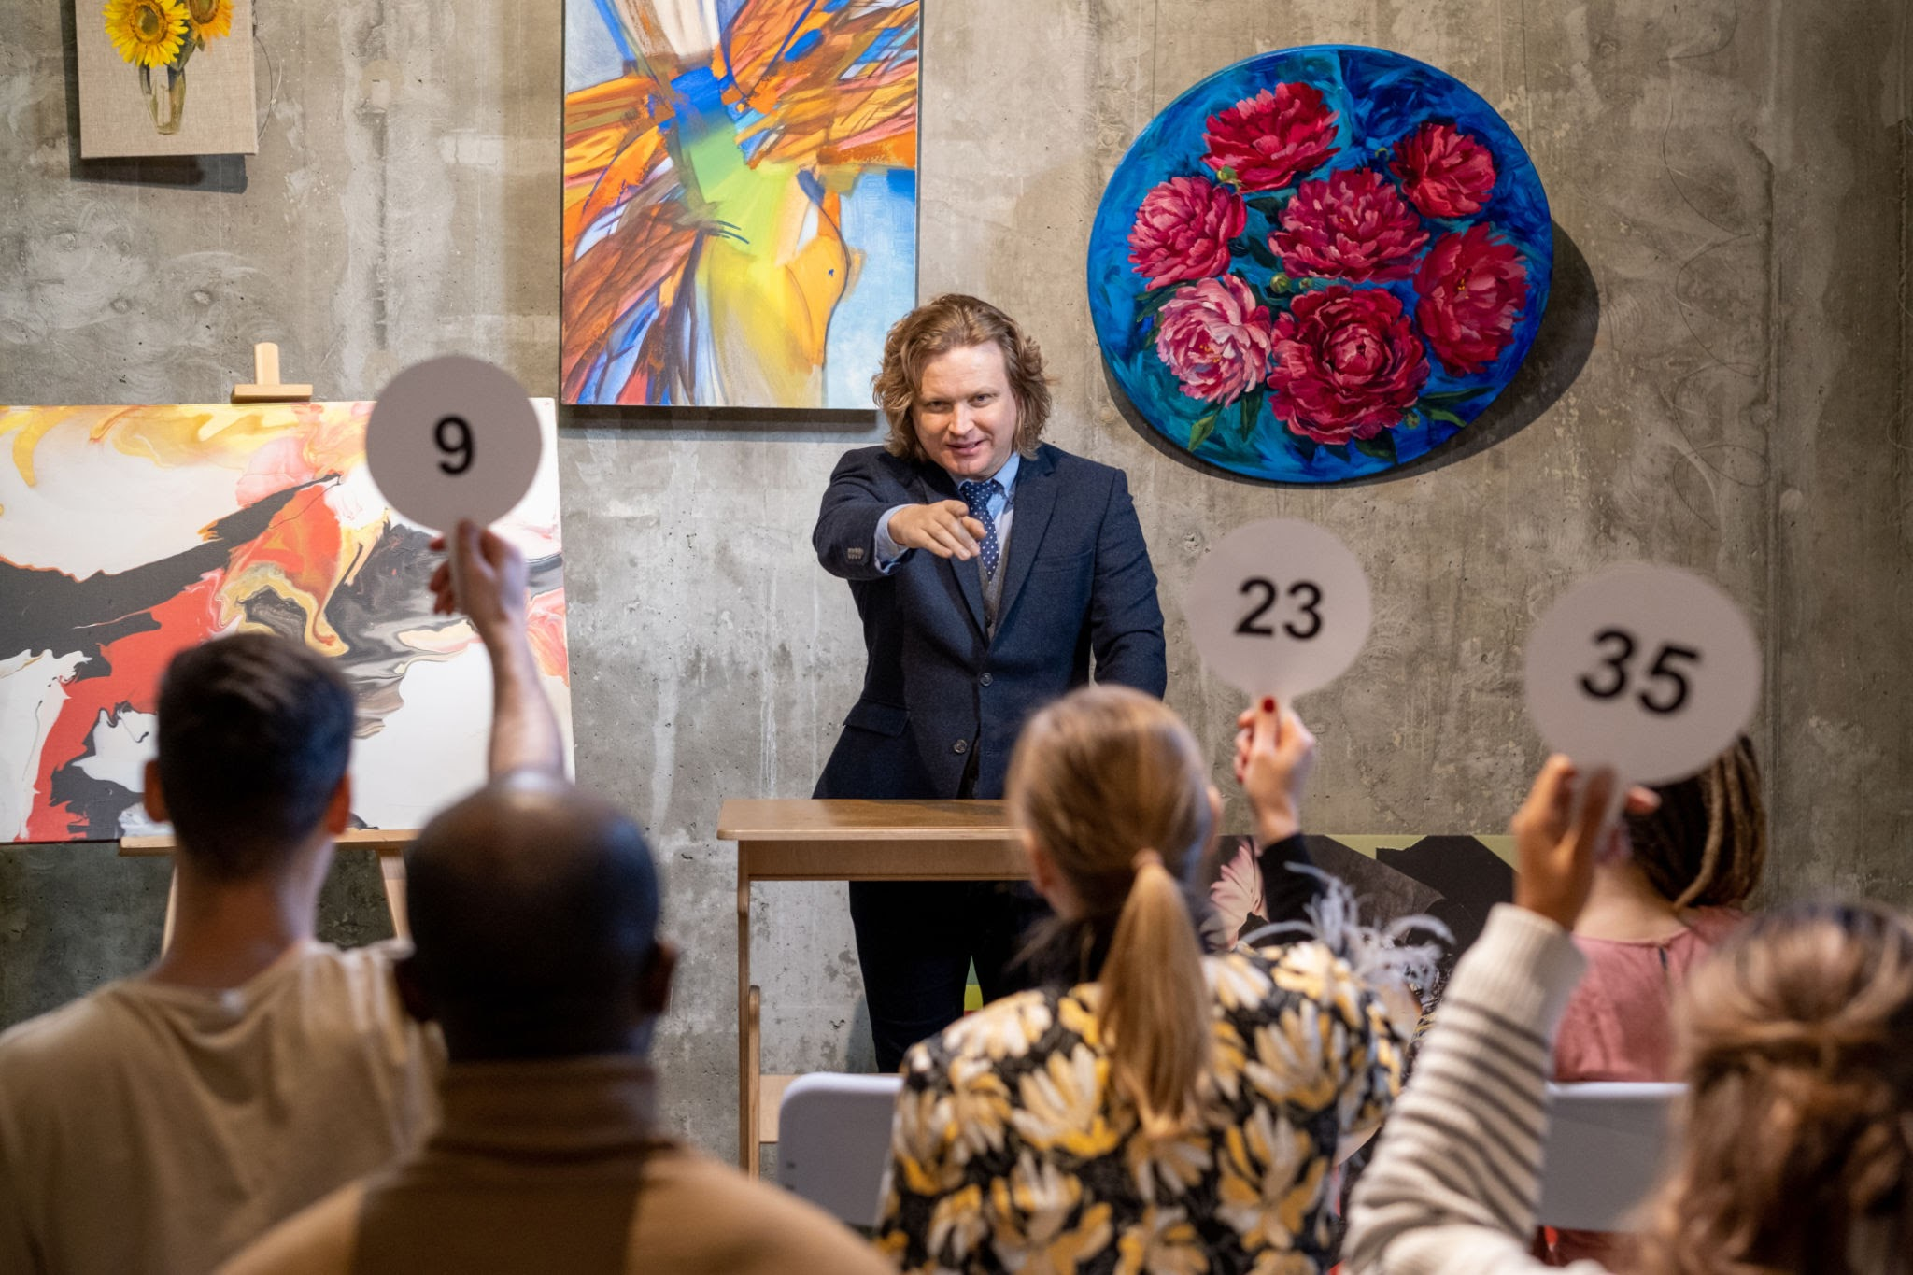
Events?

Slide 6
What is Part of a Strong Fundraising Strategy
Clear Goals
Target Audiences
Compelling Story/Case Statement
Donor Stewardship
Strong Infrastructure
Culture of Philanthropy

Slide 7
Earned Revenue
Money received for selling products, charging fees for services, or engaging in other activities where the organization provides something in return.
Examples of Earned Revenue:
Ticket sales for events
Membership fees
Merchandise sales
Fees for educational courses or workshops
Consulting services
Income from renting out space

Slide 8
Earned Revenue Considerations
Mission Alignment: If not, may be unrelated business income (UBI), which can be taxed.
Diversification: Can help orgs less reliant on traditional fundraising methods and enhancing financial stability.
Financial Resilience: A sustainable earned revenue model can help organizations fund their programs and meet growing needs.
Important Note: There are limitations on the amount of unrelated business income a nonprofit can receive without jeopardizing its tax-exempt status.

Slide 9

What’s the right mix?

Slide 10

Considerations to find the “right mix”
Assess your current situation and identify strengths and weaknesses for your organization.
Research your market and donors: Understand your target audience's preferences and monitor fundraising trends.
Plan your fundraising mix: Decide on the specific methods, allocate resources, and aim for a balanced approach.
Consider your organization's unique characteristics: the composition of your board and the nature of your mission and work influence the most suitable mix.
Don't spread yourself too thin: It's often more effective to implement a few fundraising programs well rather than attempting too many.

Slide 11
Examples
Comfort Zone Camp - gala and fall bash with strong individual follow up. Corp + Individual giving + event income
Steeltown - Indie Filmmaker Membership and Fiscal Sponsorship for their Films (sustained, monthly income + percentage of their income for their projects
Community Center - laundromat, coffee shop
Recovery Center - sober cafe, coffee shop, meeting spaces
YWCA - Dunkin’ Donuts Franchise
Individual Campaigns - not easy, not quick, constant drumbeat (takes a sustained and ongoing effort, but worth it in the long run.

Slide 12
Fundraising Basic Process
Plan
Prepare
Ask
Thank
Stewardship

Slide 13
Plan
Look Back – What have you done well, not so well? What held you back? What would/could you do differently?
Look Forward – Summary of organizational goals and strategies (should be more than one year)
Align – Fundraising goals with organizational goals
Assign – Roles and Responsibilities of Board, Staff, ED, etc.
Schedule – Create a monthly calendar of activities

Slide 14
Prepare
Case for Support – why should I give to you?
Statement of Need – What is the need for
your program and services?
Impact Statement – how do you make a difference?
Measurable Outcomes – what does success look like?
Prospect List – who are you going to ask?
Donor Research – what do they want to accomplish with their philanthropy?
Know Your Numbers - financial data, program data, data in your mission area
Rehearse the Ask – do you know your stuff?

Slide 15
Ask - sensitively but boldly
Foundations: Phone call to program officer / potential donor - Show the connection between your organization and the foundation’s funding priorities, be ready to talk finances, and invite for next meeting. Follow their lead to the grant proposal.
Social Media: positive drum beat, occasionally you can do a “plea”, but don’t overdo it.
Events: the right mix of fun and “the ask”
Corporations:want to hear how it will benefit them.
Invite them to be part of the team/family, etc.

Slide 16
Thank with genuine appreciation
Acknowledge the gift with an official letter
Thank anyone that helped you along the way, with a personal handwritten note
Phone calls – even if you have to leave a message – are great to thank and check in with donors - depends on the foundation
Social Media and Website – only if they want to be public
In-person coffee – can set up for their next gift
Gifts? – know the rules

Slide 17
Stewardship
Stewardship Definition: supervising or taking care of something
Take good care of their money: be fiscally responsible
Take good care of the organization: do what you said you were going to do
Take good care of the donor: thank them, acknowledge them, communicate with them
Take good care of the data: know who is giving what and when – and who isn’t

Slide 18

Tips and Observations
For individuals: Giving is EMOTIONAL, not logical - use stories, images, colors. Data is good, but relate it to something human
For institutions: Combination of emotional and logical
Commitment is important -- Organization’s commitment to the mission and plan AND the Asker’s commitment to the org
Authentic Gratitude and Diligent Stewardship
Do what you say you are going to do
Communicate, communicate, communicate

Slide 19
Imagine - you are a funder or donor…
What would you want to know?
How would you want to be treated

Slide 20
Thank you!

Slide 22
Foundation Grants

Slide 23
Types of Grants: Restricted vs. Non Restricted
Restricted
Specific purpose
Not “fungible” - requires specific accounting and impact tracking
Restricted in use: i.e. no overhead or no salaries
Permanent - sort of
You are not required to accept restricted funding
Non Restricted
Supports the mission, not specific programs or items
Can be used for general operating, salaries, etc
Still requires reporting, looking at the entire organization
Trust-based philanthropy

Slide 24

The Five R’s of Grantwriting
Readiness
Research
wRiting (oops)
Relationships
Reporting

Slide 25
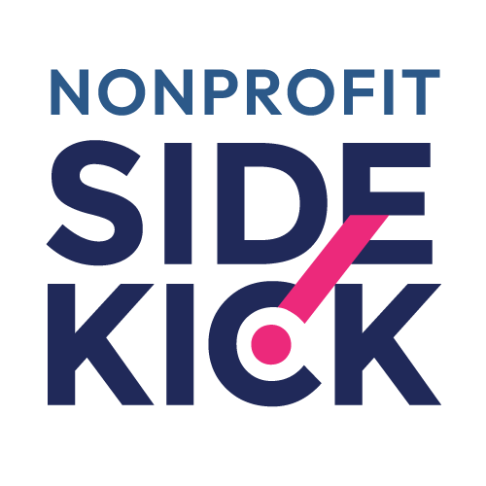
Creating a GREAT
Case Statement

Slide 26

What is a Case Statement?
"A case statement is simply a written document that states the most important facts about an organization. It can range in length from a wallet-size card to twenty pages or more. Preparing such a statement provides the opportunity to amass data that will best illustrate the competence of your staff and the effectiveness of your work."
~ Michael Seltzer

Slide 27
Why Develop a
Case Statement?
Primary benefit can be the process - not necessarily the final document
Create cohesion and clarity with staff, board, volunteers, funders - all of your constituents.
Foundation for other documents - proposals, web site copy, etc.
Differentiate your organization from other, similar organizations.

Slide 28
Case Statements Answer the Following Questions
How does this organization help?
Who do we help?
What vital services do we offer?
What is our organization's track record?
What are our plans for the future?
How do we use our money?
Why do we deserve support?

Slide 29

A Great Case Statement:
Defines the Need
Outlines the Work
Clarifies the Vision
Measures Success
Examines Finances (high level)
Builds Trust

Slide 30
The Need
What problem are you trying to solve?
Why is this a problem?
What are the effects of this problem on our community?

Slide 31
The Work
What do you do to help solve the problem?
What specific programs or services?
Do you partner with other organizations to solve the problem?

Slide 32
The Vision
What do you see in the future?
Do you have “Big Hairy Audacious Goals”
Where are you going?
People react positively to big dreams and big ideas.

Slide 33
Measuring Success
How do you know you are successful in solving this problem?
Does the measurement match the problem and the solutions?

Slide 34
Finances
Keep it high level and easy to understand, but truthful
How much does it cost to do this work?
Don’t be shy - you are only undercutting the staff by underestimating the cost
Don’t fluff.

Slide 35
Building Trust
How do I know that you can be trusted with my time, money, resources?
Have you (organization or staff) received ANY accolades, awards or recognition?
Do you have any strong testimonials or success stories you can add?
Do you have any partners, etc that can help build trust? (the crowd you run with says alot about you)

Slide 36
Feedback

Slide 37
Prospect Research

Slide 38
Foundation Prospect Research
Word of mouth
Online databases
  Foundation Directory @ Candid
  GrantStation
  GrantScape
Google - Foundation Websites
990s
Similar Organizations - who is funding them?
Association of Nonprofits - PANO, GPNP
Association of Grantmakers - GWP

Slide 39
Foundation Grants Research Tips
Hard work - Not as easy as people think
Funding Type: Restricted vs. Operating
Long Process
Research to match your mission with priorities
Watch for Mission Creep
Be Aware of Schedules and Timelines
Reporting Requirements

Slide 40
Grant Writing

Slide 41
Data and Documents to collect before you write a grant proposal
Letter of Determination
Budget (organizational and program)
Most Recent Audit and 990s
Board List (with attributions)
Demographics of Staff and Board
Past Proposals and Report
Leadership Team Bios/CVs
Letters of support from partners, collaborators, etc.
Check for others specific to foundation

Slide 42
Elements of a Typical Grant Proposal
Summary
Statement of Needs/Need Summary
Project Description Including Time Period - How are you meeting those needs?
Project Goals and Measures of Success
Project Budget
Organizational History
Organizational Budget
Sustainability Question
Anything else the funder wants to know

Slide 43
Grant Writing Tips
Never send a grant proposal in cold –
unless told to
Research foundations before you call
Be ready to pitch when you call – how much, for what, how long, partners, etc. – practice it
Have a template – but ALWAYS customize
Check your tenses and “person” - consistent and coherent
Have someone not involved in the process proofread the ENTIRE grant – including the budget
Win or lose: Partner with the foundation – communicate wins, invite to events, etc.

Slide 44
Grant Budgeting

Slide 45
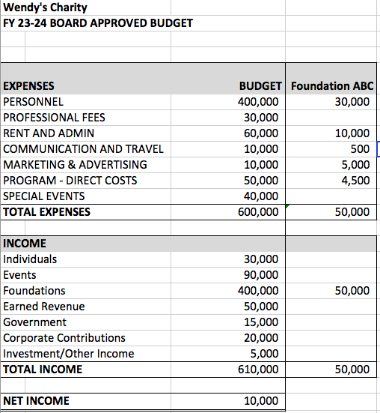

Slide 46
Grant Budgeting Dos and Don’ts
DO:
Use a board approved budget for the organizational budget
Attach a budget narrative that takes the reader line by line - explains and “shows your math”
Show matching or other funders
Take your time and get input from others to ensure you have everything necessary in the budget
DON’T:
“Guesstimate” do the work and know your numbers
Fluff or underestimate the costs
Use a different organizational budget for different grants
Ask for your entire organizational budget with one grant
Forget to proofread the budget and check formulas

Slide 47
Questions?

Slide 48
Grant Reports

Slide 49
Reporting
Starts before you submit the proposal
What do you need to track from the start - Goals and Measurements?
Who is doing the “tracking” work?
Do you need to make changes to your accounting software or process?
Not just at the end of the grant: Send updates, invite to events, celebrations, etc. throughout the grant period
Photos and testimonials are great additions
Good reporting builds relationships

Slide 50
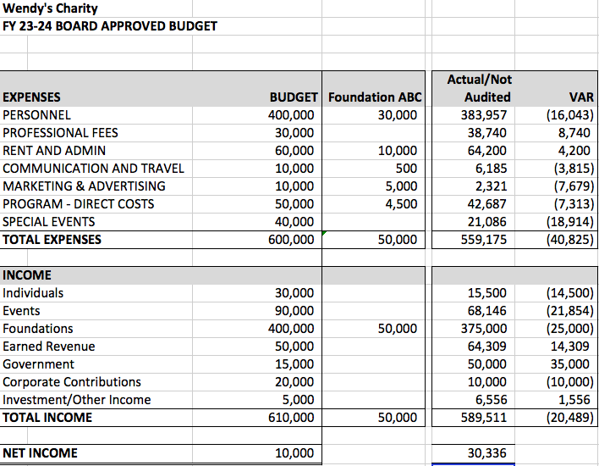

Slide 51
Online Resources for Grant Writers
Candid - Blog with Grant Proposal Samples
Grantmakers of Western PA - Grantseeker Resources
Candid - Foundation Directory
GrantStation - Online Search
Candid - Nonprofit Learning Center

Slide 52
Last Thoughts
Start early
Make the best match
Follow directions
Be authentic
Be concise and clear - Write at a 6th or 7th grade reading level
Tell a clear financial story
Proofread and then proofread again and then have someone else proofread - even the budget!

Slide 53
Questions?

