Slide 1

Nonprofit • Governance

Slide 2


Nonprofit Leadership
Development and Support
Wendy Burtner
wendy@nonprofitsidekick.com
Stephanie Masters SHRM-SCP
steph@nonprofitsidekick.com
www.nonprofitsidekick.com

Slide 3
Nonprofit Governance is a System of
Bylaws
Policies
People
The main governing document for a nonprofit organization.
Written rules to protect and steer the staff and board as they fulfill the mission of the organization.
Board and Staff charged with upholding the bylaws and interpreting and enacting the policies.

Slide 4
Bylaws: 5 Things to look for
Terms and term limits for board members
Members: a range or number, demographics, directors and officers, and definition of a quorum
The frequency of meetings
The types of meetings and communications allowed
Committee structure
Change them or change your behavior!
If you change them, board approves and then include a copy with next 990

Slide 5
7 Policies
Conflict of interest policy and
annual disclosure
Whistleblower protection policy and its dissemination
Document retention and destruction policy
Gift acceptance policy/Investments
Executive compensation and benefits review policy and procedure
Form 990 review and approval policy and procedure
Joint Venture Policy
Public accountability similar to a publicly traded company - Sarbanes Oxley Act of 2002 - not always required but considered best practice.

Slide 6
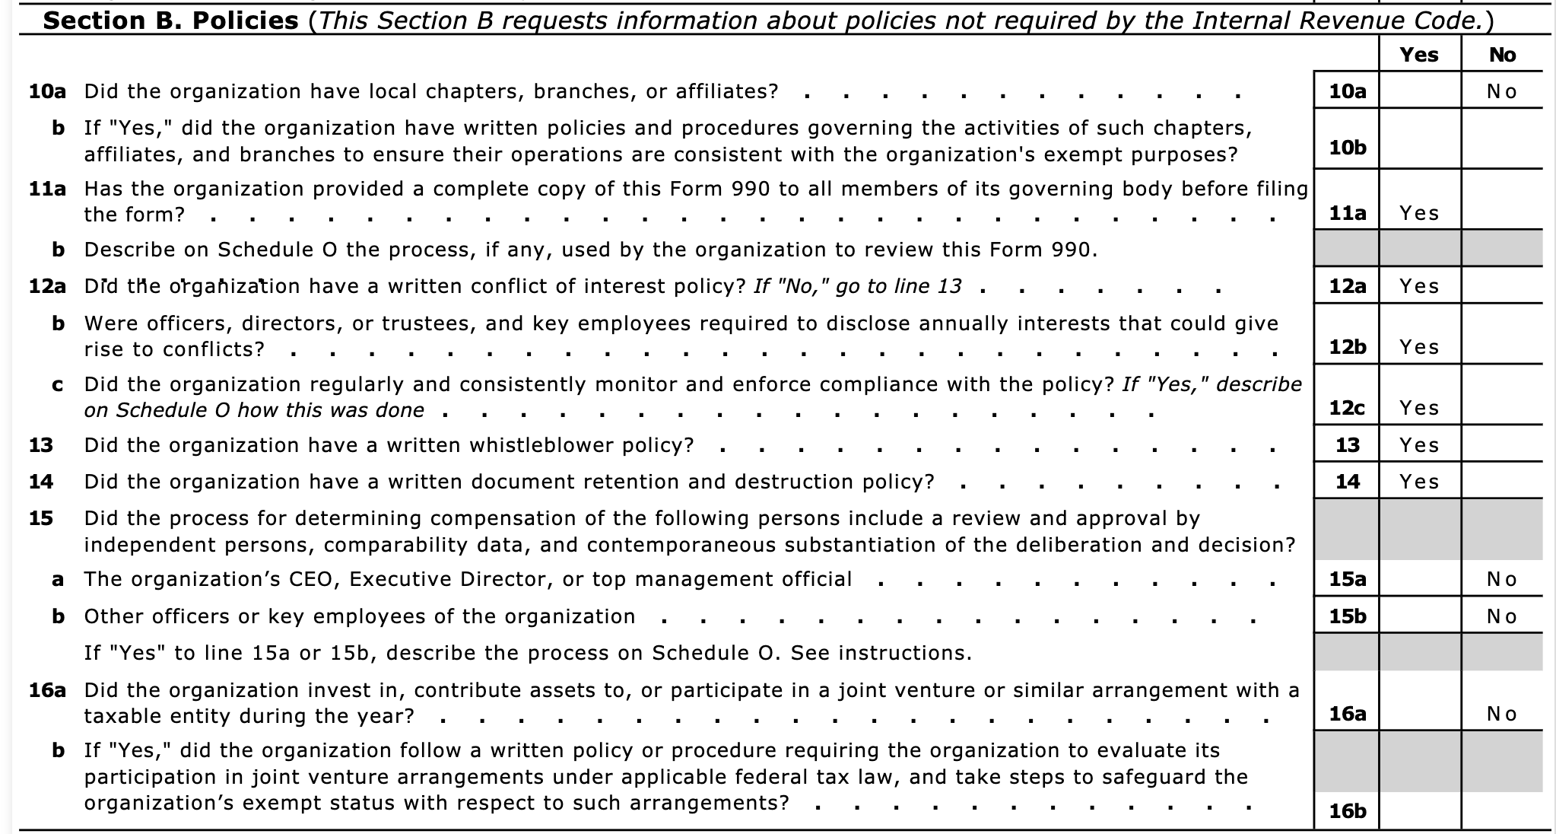

Slide 7

Why do nonprofits have boards?

Slide 8
Public Accountability
& Transparency
Double
Bottom
Line

Slide 9
Board Member Independence
Defined as “no financial or familial relationships between the director and the organization.” At the very least, nonprofits should consider whether such relationships affect the ability of the director and the board to act in the best interests of the organization.
Free from a conflict of interest and not compensated more than $10,000 as a contractor/vendor
Not compensated as an employee of the organization
Not related to anyone that is compensated by the organization

Slide 10
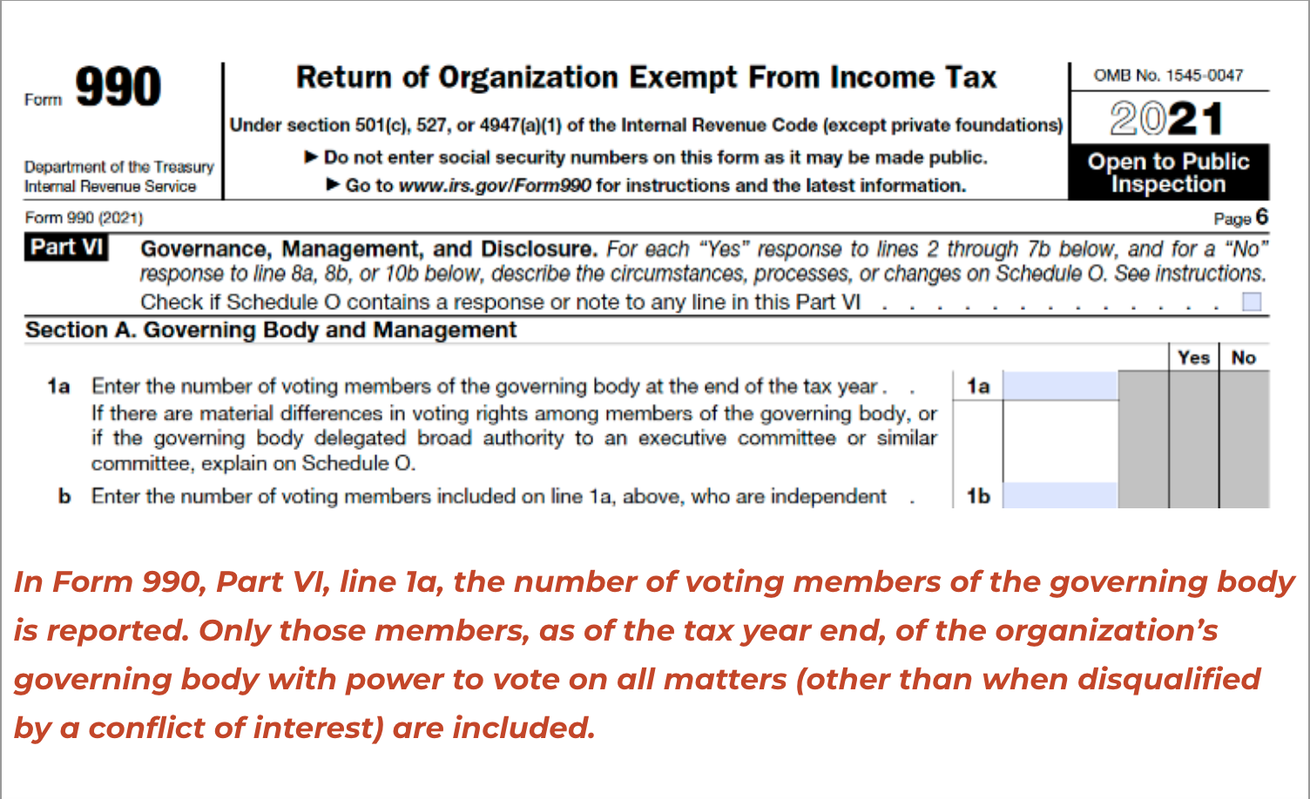
The majority (some say ⅔) of board members should be independent.

Slide 11
Governing Board
vs.
Advisory Board

Slide 12
fiduciary
noun
a person or organization that acts on behalf of another person or persons, with a legal and ethical obligation to put that person’s interest ahead of their own.

Slide 13

Board Member Fiduciary Duties
Duty of Care
Each board member has a legal responsibility to participate actively in making decisions on behalf of the organization and to exercise his or her best judgment while doing so. This applies to the mission/purpose as well as sustainability/finances.
Duty of Loyalty
Each board member must put the interests of the organization before their personal and professional interests when acting on behalf of the organization in a decision- making capacity. The organization’s needs and mission/purpose come first.
Duty of Obedience
Board members bear the legal responsibility of ensuring that the organization complies with any and all applicable federal, state and local laws and, just as importantly, adheres to and works to fulfill its mission and purpose.

Slide 14
Who is legally accountable for a nonprofit organization’s action?
The Board

Slide 15
Managing Risk – Insurance
General liability coverage responds to claims alleging bodily injury and property damage.
Professional liability coverage responds to claims alleging negligence in the delivery of professional services.
Directors and Officers policies respond to claims alleging wrongful management decisions. In some cases defense costs are in addition to the limit of liability, while in other policies funds spent on legal defense reduce the limit available for judgments and settlements.

Slide 16

Managing Risk – Engagement
Pay attention
Read the reports, emails, etc.
Attend board meetings
Ask questions
Understand the expectations of your position
Maintain open communications - listen

Slide 17
Three “Types” of Nonprofit Governing Boards
Working
Guiding
Institutional
Actively doing the work of the organization (management + governing)
Few or no staff
May transition into a non-working board as the organization grows
More emphasis on leadership and duties
Operational framework that includes staff
Committees become important and effective
More Governing, less Managing
Understand their role in governing the organization
Sees fundraising as key responsibility
Often grows in number
Staff is managing the work of the organization
Governing, not Managing

Slide 18
Board Member Roles
01
02
03
04
Team Member/ Mission Expert
Ambassador
Fundraiser
Financial Leader

Slide 19
Team Member / Mission Expert
Takes the time to learn about the organization - its goals, strategies, priorities - becomes a mission expert
Takes the time to build relationships with staff - learn about them personally and professionally
Considers themselves part of the team, uses “we” language and fully participates in the cause
Looks for ways to innovate, flex, pivot that best suit the organization
01

Slide 20
What makes
a great Ambassador?
Proud of the affiliation
Talks about the organization to others - tells stories about the mission impact, etc.
Shares social media posts
Shows up when asked/needed and becomes an authentic supporter of the mission
02

Slide 21
Boards and Fundraising
Understand how and where the org fundraises
Make a personal donation that is
meaningful to you
Make strategic introductions to your network
Host a small gathering and share your story and connection to the mission (or large gathering!)
Educate your network and beyond on the importance of your organization
Share specific stories about your impact and invite others to see your work firsthand
Make thank you phone calls to donors
03

Slide 22
Financial Leaders
Know and understand the numbers and financial reports
Look ahead - prioritize cash flow and plan for reserves
Critically examine the budget - not just rubber stamp
Staff financial management either through a contract or hiring a qualified financial manager
Consider diversifying income mix
04

Slide 23
Running Partners on a Mission

Slide 24
Board Development/ Succession Planning

Slide 25
Board Composition - create a matrix
What skills/ experience/ demographics do you want and/or need on the board?
What skills/experience/ demographics does your current board already have?
Where are the gaps? This is your recruitment directive.

Slide 26
Board Matrix/Composition Chart
 | Marketing / Fundraising | Program Experience | Corporate Connections
Sherry | Extensive | Some | None
Paul | None | Extensive | None
Nisha | Extensive | None | Some

Slide 27
Board Composition - what do they WANT to do?
Why is this board member joining your board?
How do they want to leverage their strengths and skills to benefit your mission?
Do you have the variety of strengths, skills and attitude or mindset needed for your board to be successful?

Slide 28
Board Building Cycle
Identify Skills & Demo-
graphics
Evaluate & Rotate
Cultivate
Educate & Involve
Recruit
Orient
BoardSource

Slide 29
Board Recruitment and Onboarding
Whose job is recruitment?
When should you be thinking about recruitment?
Do your research on prospects
Find PASSION for the mission, but make sure there is alignment with strategy and strengths
PLAN - Have an onboarding process - orientation, board book, clear expectations, clear introductions
Welcome and nurture them - ask them questions/give them room to speak, check in after the first few meetings at least
Training in nonprofit governance and collaborative leadership

Slide 30
Nonprofit Leadership Frameworks

Slide 31
Hierarchy
Board of Directors
Executive Director
Program
Development
Finance
Marketing
Notes:
Most of us have some version of this as our org chart, but how much time does your Board have to truly Manage the ED? Shared or diffused leadership - talk about Jim Collins definition.

Slide 32
Silos
Board Chair
Executive Director
Leads the Board
1
1
Leads the Staff
MISSION
MISSION
MISSION
Vision
2
2
Implementation
Governing
3
3
Managing

Slide 33
Collaborative Leadership
An inclusive leadership style that gathers input and ideas from a variety of sources before making decisions or taking action. Authority is diffused.
Inspires Trust
Positivity
MISSION
Transparency
MISSION
Delegation
MISSION
Communication
Collaborative Leadership
Encourages Innovation
Relationship Building
Risk Taking
Vulnerability
Mediates Conflict
Solves Problems

Slide 34

Running Partners on a Mission
Us / Them
We / Team

Slide 35
3 Important Ingredients for
Nonprofit Leadership Success
A great relationship between ED/CEO and board chair that is based on trust and shared expectations
A clear strategy that ties back to vision, mission
and impact
Strong leadership skills - executive AND legislative - and the ability to know when to use which one
= Communication
= Organization
= Leadership

Slide 36

Board Tips
Work toward building a strong relationships
Include some board training into the schedule every year, also team building activities
Design an orientation program that helps new members start off on the right foot
Carefully consider board composition - match with where the org is on the lifecycle
Intentionally create a culture where the board is part of the team
Have clear fundraising requirements, if you must have any
Make sure every committee has leadership, purpose and goals

Slide 37
Thank You!

