Slide 1
Succession • Planning

Slide 2


Nonprofit Leadership
Development and Support
Wendy Burtner
wendy@nonprofitsidekick.com
Stephanie Masters SHRM-SCP
steph@nonprofitsidekick.com
www.nonprofitsidekick.com

Slide 3

Why succession planning?
Prevent loss of legacy knowledge and practices
Minimize risk of organizational failure
Retain relationships
Financial sustainability
Create a strong transition for new leadership, reducing frustration and potential loss of talent

Slide 4

Characteristics of Succession Planning
Proactive
Collaborative
Self-assessment
Expectation-setting
Preparation (Emergency Plan)

Slide 5
How Much Time Do You Have?
More than 6 mo?
Succession Planning
2 – 6 months?
Executive Search/ Board Recruitment
Less than 2 mo?
Emergency Transition

Slide 6


What could trigger an emergency transition?
Unexpected or Expected Board Chair Turnover
Significant Board Turnover
Performance Evaluation of the ED
ED Resignation
Crisis involving ED – Internal or External
The Proverbial Bus or Lottery Win
Procrastination

Slide 7

“Emergency Planning” is the foundation of Succession Planning, kind of like prepping for the Zombie Apocalypse

Slide 8
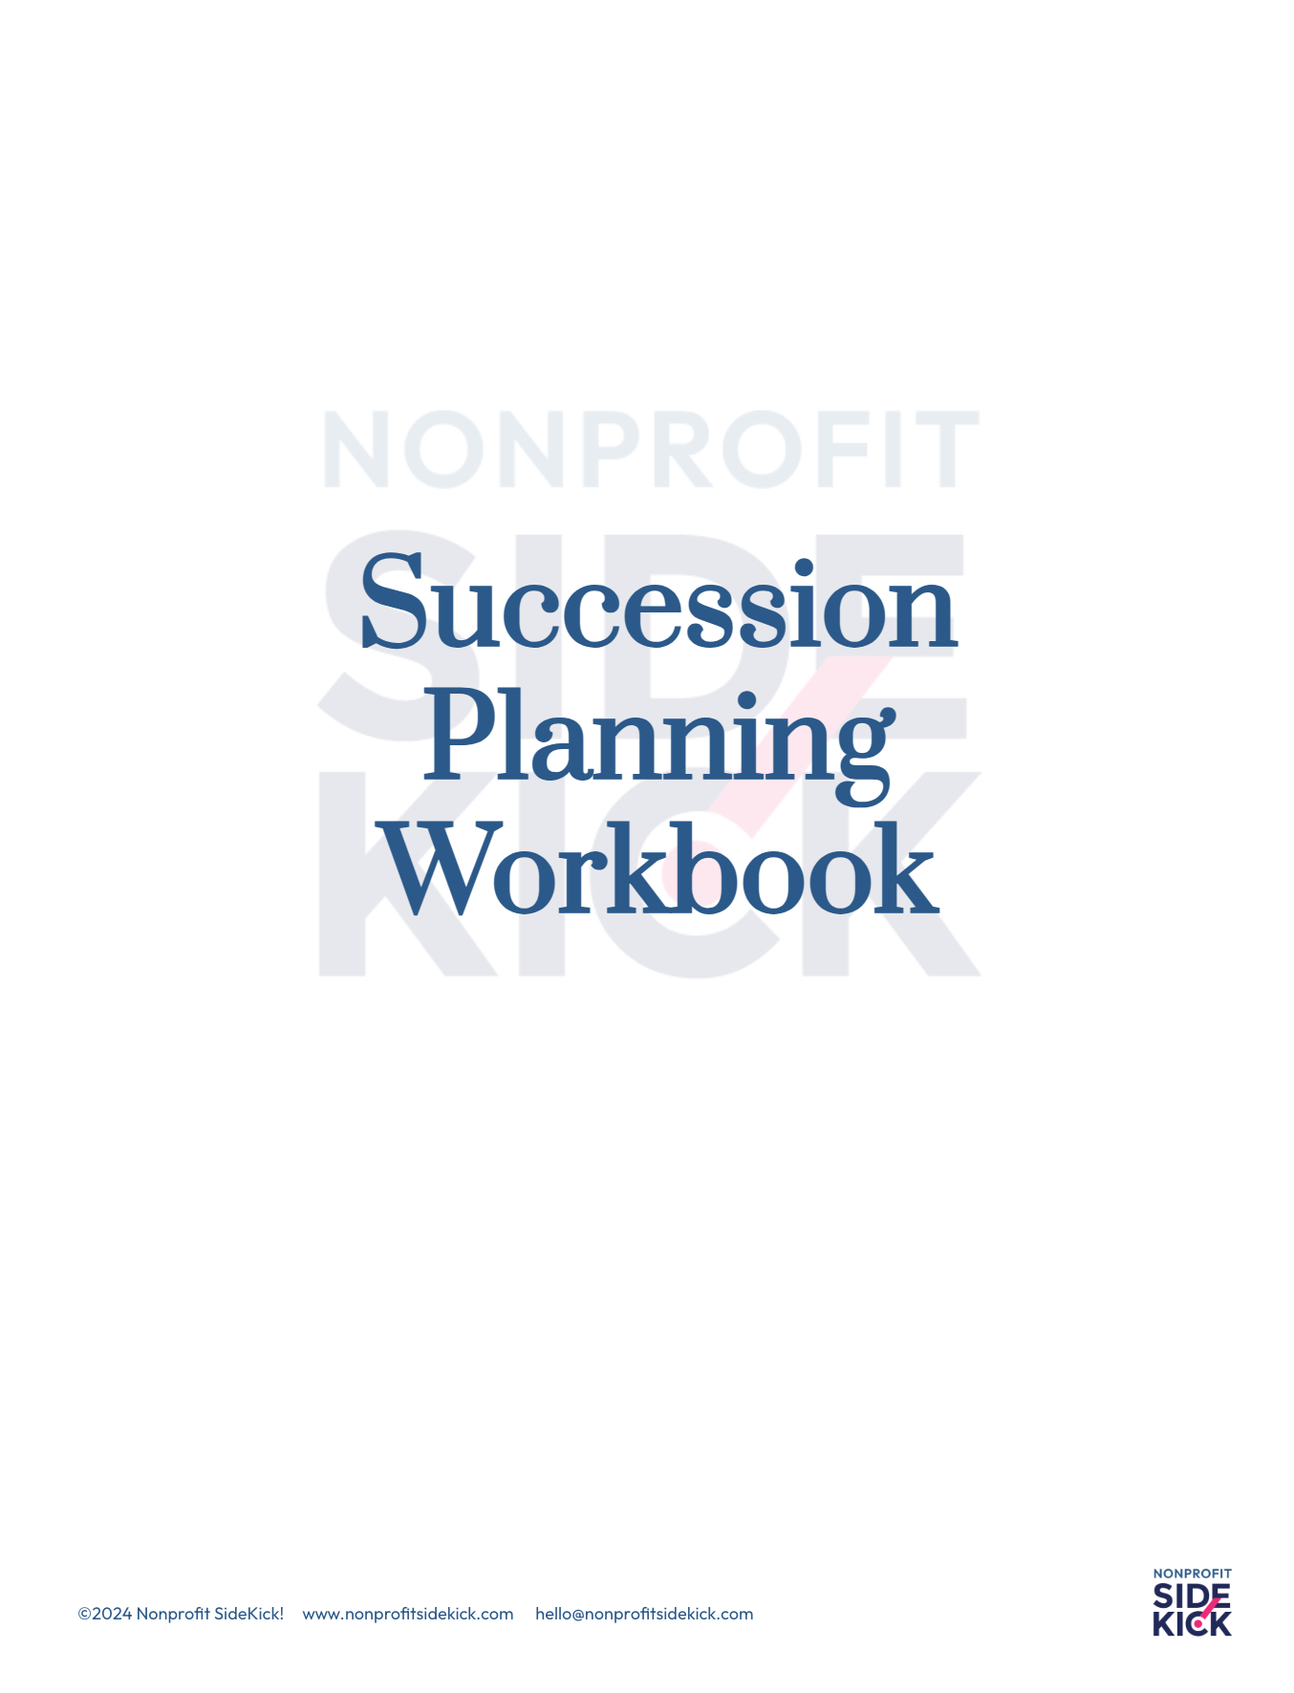

Slide 9
Four Ingredients = Foundation
Communications Planning
Financial Management
Think of the worst case scenario in each area
Keep this information somewhere safe
Review answers periodically
Passwords +
Interim Management
Risk Management

Slide 10
Communications
The Team
Who is the transition communications lead?
Who else is on the communications team? Staff? Board?

Slide 11
The Message
What happened?
When is the transition?
Why is the transition happening?
Who is in charge now?
Who are the contact people?
Is the organization stable?
Are there specific times that additional messaging should be released?
Are the upcoming communications opportunities that need to be delayed or pushed to the forefront?
Need the questions, not the answers.

Slide 12
Who gets what message, when?
Who needs to get the communication?
Who are the primary, secondary and tertiary stakeholders?
Which vehicle is appropriate for each stakeholder or stakeholder group?
Who are the key contacts within your organization with important relationships - funders, clients, partners, collaborators, vendors, etc.

Slide 13
Sample Table for Comms
Level | Stakeholder | Vehicle | Org. Lead | 2nd Contact
Primary | Major Funder | Phone Call | Board Chair | Dev. Director
Secondary | Program Partner | Phone Call | Program Lead | ED
Tertiary | Landlord | Email | Ops Lead | ED

Slide 14
Financial Management
Who is on the team?
See handout for specific questions for:
Accounts
Bookkeeping/accounting
Payroll
Grants
General Financial Management/Policies and Procedures
Tax/audit

Slide 15
Risk Management
Facilities
Insurance
Technology
Staff/Volunteer Moral
Funder obligations
Partners/collaborators

Slide 16
Interim Management
Does our organization have expertise
in-house to address specific, executive-level management issues?
How will the board support the interim leader?
How urgent is our situation? Is there time to complete a search before filling the position, or are there urgent issues to be addressed now?
Are we preparing our in-house talent for promotions?
Are there significant transition issues that must be addressed before we can pursue a permanent solution?
Sample questions - many more in the handout

Slide 17


You are now “prepped” - What’s next?

Slide 18
Staff Leadership Succession Process
Sustaining
Transitioning
Onboarding
Ideally, 1-2 years before start of transition.
Leader sustains org.
Board prepares for search
Identify critical knowledge transfer
Early (primary) communication commences
6-12 months before / during “hand off”
Leader sustains org
Board leads search
All hands on deck
Communications (internal and external) are key
6-12 months supporting the new leader
Exiting leader MIGHT consult, but not necessary
Board engages and builds relationship with new leader
New leader is introduced to stakeholder and constituents

Slide 19
Phase 1: Sustaining
Understand/define the leader’s role and responsibilities
Clarify expectations between leadership - board/staff
Identify, cultivate and train any internal candidates
Outline executive search process
Emergency transition plan
Strategic planning (?)

Slide 20
Phase 2: Transitioning
Executive search
Leader focuses on managing staff and remaining transparent and supportive
Prepare for onboarding, knowledge transfer of what they need to know (see emergency plan)
Prepare for relationship hand-offs
Implement communications plan for announcement

Slide 21
Phase 3: Onboarding
More than one day, but that first day is important
First 100 days, conduct “Stay Interviews” at 30/60/90 days
Plan for internal and external relationship building (Leverage an assessment)
Strategy and vision alignment
More involvement than usual
Focus on relationship building

Slide 22
Succession Planning for the Board

Slide 23
Board
Building
Cycle
Identify Skills & Demo-
graphics
Evaluate & Rotate
Cultivate
Educate & Involve
Recruit
Orient
BoardSource, 2008

Slide 24
Board Matrix/Composition Chart
 | Marketing / Fundraising | Program Experience | Corporate Connections
Brian | Extensive | Some | None
Paul | None | Extensive | Some
Nisha | Extensive | None | Some

Slide 25
Board Tenure Tracking Chart
 | 2021 | 2022 | 2023 | 2024 | 2025 | 2026 | 2027
Abe
Barb
Connie
Dave
Earl
New 1
New 2
New 3
New 4
New 5
Bylaws:
5 members
3 year terms
2 term limit

Slide 26
Board Tenure Tracking Chart
 | 2021 | 2022 | 2023 | 2024 | 2025 | 2026 | 2027
Abe
Barb
Connie
Dave
Earl
New 1
New 2
New 3
New 4
New 5
Bylaws:
5 members
3 year terms
2 term limit
Dave leaves after 1 term

Slide 27
Board Recruitment and Onboarding
Whose job is recruitment?
Not just for November
Do your research on prospects
Find PASSION for the mission, but make sure there is alignment with strategy
PLAN - Have an onboarding process - orientation, board book, clear expectations, clear introductions
Welcome and nurture them - ask them questions/give them room to speak, check in after the first few meetings at least

Slide 28

Board Officer Succession Planning

Slide 29
Succession Planning Tips
Understand the strategic priorities of the organization
Understand the job you are trying to fill: Define expectations and competencies, DO NOT just replace with the same or the opposite
Consider Interim Leadership - “slow down to go fast”
Having and following a communications plan is more important that you think.
Define the role of the outgoing leader in the process
Invest in new leader development, coach or mentor
Design and implement process for evaluating the new person

Slide 30

Thank You!

